Slide 1
FLOWERS AURA
​

Slide 2
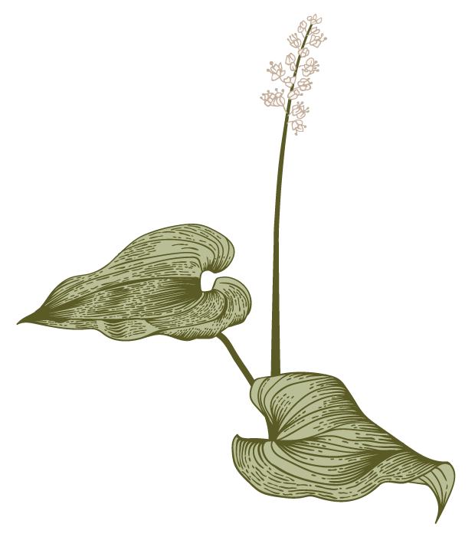

Agenda
A
Introduction
Abstract
Software Requirements
content
conclusion

Slide 3
Introduction
Cloning a website to get a specific look or function is a great way to kickstart a design. But one thing not want to copy is the actual content of the site. In many cases, things like text, images, and other visual assets are unique to a site.

Slide 4
ABSTRCT
Nowadays the people didn’t know significance of flowers. We are missing out on the little things that holds weight for different types of festivals. so we are here on the informative side to show the significance of each flower on the seasonal basis.

Slide 5



Software requirements
​
t
n

Slide 6
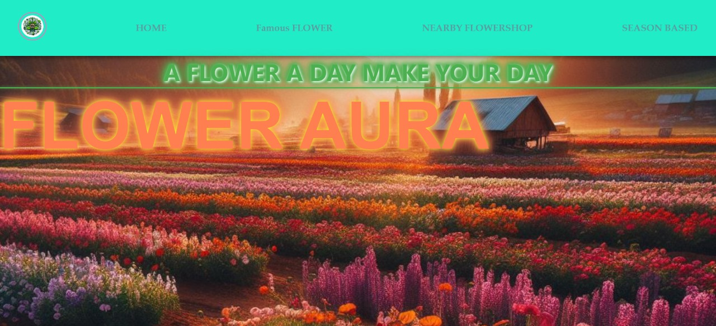

Slide 7
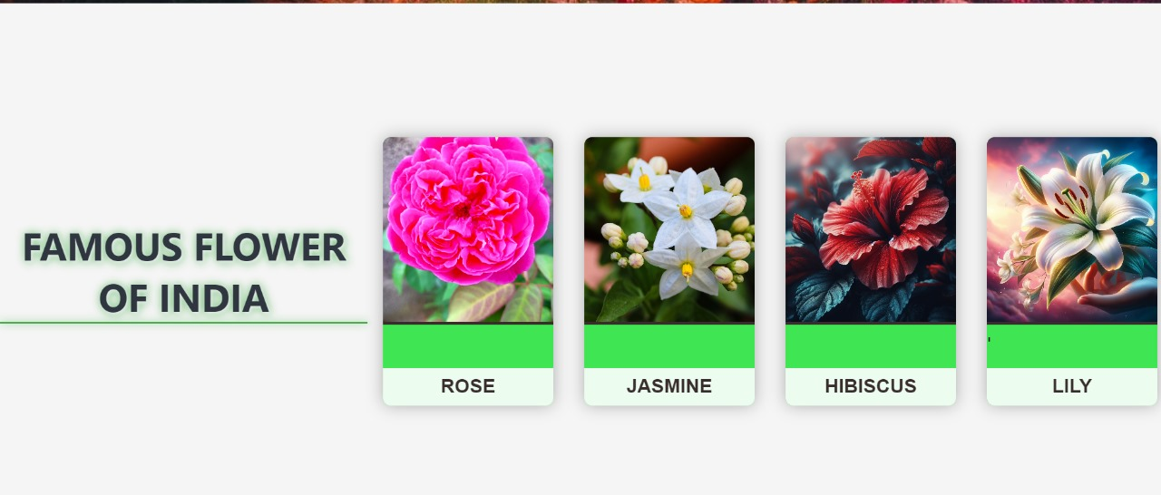

Slide 8
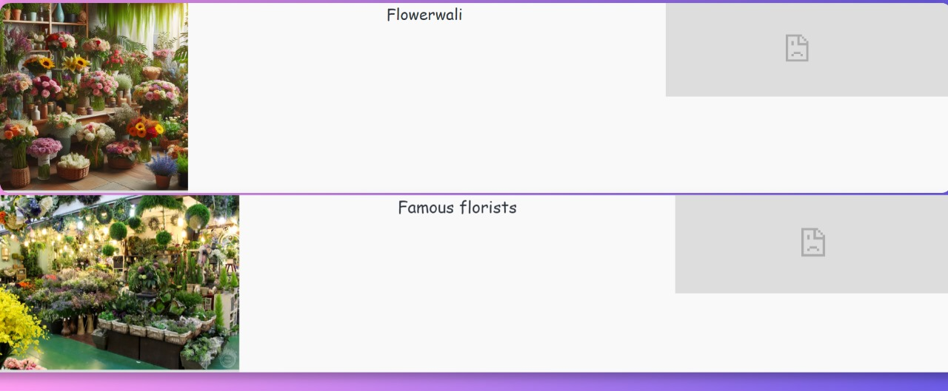

Slide 9
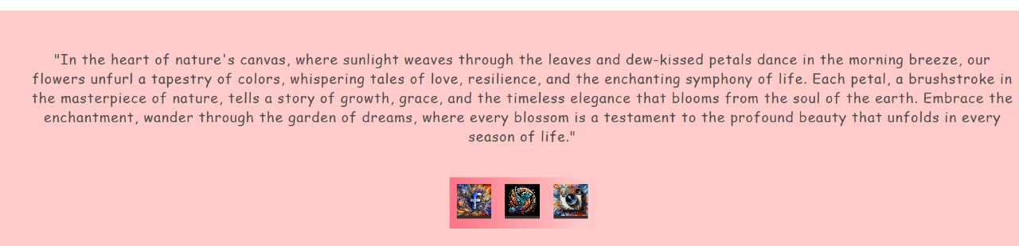

Slide 10
Thank you
N.Lakshmi Priyanka
1602-22-737-319
E.Archana
1602-22-737-135
M.Sheetal
1602-22-737-176

